Slide 1
Manipulating Pictures, Arrays, and Loops part 2
Barb Ericson
Georgia Institute of Technology
May 2006

Slide 2
Learning Goals
Understand at a conceptual and practical level
  What a 2-dimensional array is
  How to get a pixel at a given x and y location
  How to use the picture explorer
  Why we need some way to repeat a series of statements
  What a for-each loop is
  What a while loop is

Slide 3
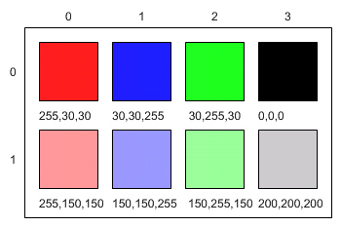
Pictures are 2-D Arrays
They have columns and rows (x and y)
You can get a pixel at a particular x and y location
  Pixel pixelObj = picture.getPixel(x,y);
The columns and rows
  start with index 0
  end with num -1
X
Y

Slide 4
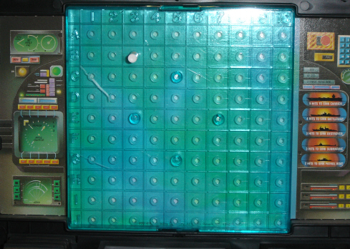
2-Dimensional Array Exercise
Have two students play battleship.
  Have other students keep track of the play based on the rows and columns (I-5) or even switch this to (5-I) so that it is (x,y)
Or play Bingo
  And let everyone have practice with looking up the right position

Slide 5
Changing a Picture Exercise
> import java.awt.Color;
> String fileName = "C:/intro-prog-java/mediasources/caterpillar.jpg";
> Picture pictureObj = new Picture(fileName);
> pictureObj.show();
> pictureObj.getPixel(10,100).setColor(Color.black);
> pictureObj.getPixel(11,100).setColor(Color.black);
> pictureObj.getPixel(12,100).setColor(Color.black);
> pictureObj.getPixel(13,100).setColor(Color.black);
> pictureObj.getPixel(14,100).setColor(Color.black);
> pictureObj.getPixel(15,100).setColor(Color.black);
> pictureObj.getPixel(16,100).setColor(Color.black);
> pictureObj.getPixel(17,100).setColor(Color.black);
> pictureObj.getPixel(18,100).setColor(Color.black);
> pictureObj.getPixel(19,100).setColor(Color.black);
> pictureObj.repaint();
Notes:
Type the above code in the interactions pane and see what happens. You can use the up arrow to pull up the last statement executed in the interactions pane and then use the left arrow to get to the number to change.

Slide 6
How do we Know if it Worked?
A very important part of programming is testing the result
  Just because code compiles and runs without error doesn’t mean it is correct
  There could be an error in the logic
  It could fail under certain conditions
  It could even return the correct answer but for the wrong reason

Slide 7
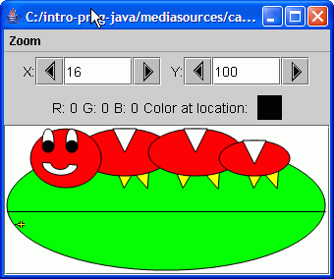
The Picture Explorer
Tool that creates a copy of the current picture and lets you explore it
  See the color, x, and y values at the cursor
To use the tool on a picture object
  pictureObj.explore();
Use it to see if the colors have changed
Notes:
You can type in the X and Y value that you want to check the color of and press enter and it will display the red, green, and blue values at that position. The crosshair will also display at that position.

Slide 8
Changing the Red in a Picture
One way to change a picture is to reduce the amount of red in it
  What if we want to decrease it by half?
    If we have a value of 200 what should the new value be?
    How do we reduce any value by half?
  What if we want to increase it by 25%?
    If we have a value of 100 what should the new value be?
    How do we increase any value by 25%?
Notes:
To decrease the red value by half multiply it by 0.5 or divide it by 2. To increase the red value by 25% multiply it by 1.25.

Slide 9
Changing all the Pixels in a Picture
There are 329 * 150 = 49,350 pixels in the caterpillar picture
Do we really want to write the code to change each one of these?
  Get the current pixel
  Get the red value of the current pixel
  Change the red value of the current pixel to half the original value (value / 2)
  Put the new red value in the current pixel

Slide 10
We Need a Loop (Iteration)
A way to execute a series of statements in the body of the loop
  With something changing each time the statements are executed
    Different pixel to change
  And some way to tell when we are done with the repetition
    Some test to see if the loop should stop
      Done with all of the items in an array

Slide 11
For-each Loop
In Java if we want to do something to each item in an array
  We can use the for-each loop (new in 1.5)
    for (Type : variableName arrayName)
    {
    // body of the loop
    }
  Which means for each element in the array do the statements in the body of the loop

Slide 12
Method to Decrease Red
Loop through all the pixels in an array of Pixel objects and change the red in each
public void decreaseRed()
{
Pixel[] pixelArray = this.getPixels();
int value = 0;
// loop through all the pixels in the array
for (Pixel pixelObj : pixelArray)
{
// get the red value
value = pixelObj.getRed();
// decrease the red value by 50% (1/2)
value = value / 2;
// set the red value of the current pixel to the new value
pixelObj.setRed(value);
}
}
The body of the loop is in {}

Slide 13
Testing decreaseRed
Add decreaseRed to Picture.java
  Before the last }
Compile Picture.java
  Click on Compile All Button
Type the following in the interactions pane
  > String fileName = FileChooser.pickAFile();
  > Picture pictObj = new Picture(fileName);
  > pictObj.explore();
  > pictObj.increaseRed();
  > pictObj.explore();
Notes:
Use the two picture explorers to compare the red values.

Slide 14
How This Works
First we have the method declaration
  public void decreaseRed()
  This is a public method that doesn't return anything and the name is decreaseRed. This method does not take any parameters since there is nothing in the ()
Next we start the body of the method
  {
  Inside of the body of the method are the statements to be executed when the method is called (executed)
Next we declare an array of pixels and get them from the current Picture object
  Pixel[] pixelArray = this.getPixels();
Next we declare a primitive variable to hold the current red value at the pixel
int value = 0;

Slide 15
How This Works - Cont
Next start the for-each loop
  for (Pixel pixelObj : pixelArray)
  {
  Each time through the loop set the variable pixelObj to refer to the next Pixel object in the array of Pixel objects called pixelArray. Execute the statements in the body of the loop.
Get the red value from the pixelObj
value = pixelObj.getRed();
Decrease the red by 1/2
value = value / 2;
Set the red value at the pixelObj to the new value
pixelObj.setRed(value);
End the for-each loop body and the body of the method
}
}

Slide 16
Exercise
Write a method increaseRed() to loop through all the pixels in a picture and double the red values
  Multiply by 2
To try this method do the following:
  String fileName = FileChooser.pickAFile();
  Picture pictObj = new Picture(fileName);
  pictObj.explore();
  pictObj.increaseRed();
  pictObj.explore();

Slide 17
Loop Exercise
Ask a person to clap 12 times
  How does s/he know when to stop?
  What changes each time s/he claps?
If you are following a recipe that asks you to stir the ingredients 50 times how would you do this?
What if you were trying to break a sit-up record
  How would you know if you did break it?

Slide 18
Loops often need Counters
If you want to do something x times you often need a counter
  That starts at 0
  And you add 1 to it each time you finish doing the thing you are repeating
  When the counter reaches the number you are trying to do you stop the loop
    What is the value of the counter the last time the statements of the loop are executed?
Notes:
The counter is also often referred to as an index.

Slide 19
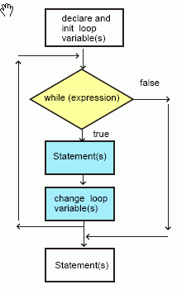
While Loops
In Java one way to repeat a block of statements while an expression is true is to use a while loop
Create a counter and set it to the start value
Check that the counter is less then the stop value
If it is less than execute the statements in the loop
Add one to the counter and go back to check that the counter is less than the stop value
Notes:
The picture is a flowchart which shows the order the statements are executed in a program. A while loop allows you to repeat a series of statements until an expression is false.

Slide 20
Total the Numbers from 1 to 100
What if you want to add all the numbers from 1 to 100?
  You will need something to hold the total
    What type should it be?
    What value should it start out with?
  You will need something that counts from 1 to 100
    And add that value to the total
    Stop when you get to 100
    What type should it be? What value should it start with?

Slide 21
While Loop Syntax
Adding up the numbers from 1 to 100
  int total = 0;
  int num = 1;
  while (num <= 100)
  {
    total = total + num;
    num = num + 1;
  }
  System.out.println(total);
Notes:
When you type the above code into DrJava you will need to do Shift-Enter when you type the while loop code in (so that it doesn’t try to evaluate the while loop till you have all the code entered.

Slide 22
While Loop Syntax
Adding up the numbers from 1 to 100
  int total = 0; // declare and initialize the total
  int num = 1; // declare and init the number
  while (num <= 100) // do while num <= 100
  {
    total = total + num; // add num to total
    num = num + 1; // increment the num
  }
  System.out.println(total); // print the total
Notes:
When you type the above code into DrJava you will need to do Shift-Enter when you type the while loop code in (so that it doesn’t try to evaluate the while loop till you have all the code entered.

Slide 23
Parts of a While Loop
Adding up the numbers from 1 to 100
  int total = 0;
  int num = 1;
  while (num <= 100)
  {
    total = total + num;
    num = num + 1;
  }
  System.out.println(total);
Declaration and initialization of variables
This test is done each time and when
It is true the loop body will be executed
This is the body of the loop. It
Starts with a ‘{‘ and ends with
a ‘}’. If there is just one statement
In a loop body the ‘{‘ and ‘}’ aren’t
needed.
Notes:
When you type the above code into DrJava you will need to do Shift-Enter when you type the while loop code in (so that it doesn’t try to evaluate the while loop till you have all the code entered.

Slide 24
Exercise
Have students walk through this flowchart
int count = 0;
int diceValue = rollDice();
Roll a die to get this value
while (diceValue < count)
false
true
System.out.println("My name is " + name);
Sytem.out.println("The count is " + count);
count = count + 1 ;
System.out.println("After the loop the count is " + count);

Slide 25
Summary
A 2d array has columns and rows
You can get a pixel at a particular x and y location
You can use a for-each loop to execute a series of statements on each item in an array
You can use a while loop to repeat a series of Java statements while some test is true
  Often you will use a counter to get track of how many times the loop has executed
  Declare the counter before the loop and increment it at the end of the loop

